Slide 1

Department of Information Technology Major Project Final Air Pollution Measurement & Analysis
Guided by:- Presented by:-
Dr. K. JAYANTHI, SUMANT KUMAR(16155)
M.Tech., Ph.D., SAHIL SINHA(15261)
Assistant Professor T.VEDANSHU RAJ(16151)
https://www.veltech.edu.in

Slide 2

Meeting with Guide summary
S.No | Date | Time | Discussion | Remarks
1. | 20/01/23 | 7:00 pm | Regarding Project | Proceed
2. | 21/01/23 | 8:00 pm | Dicussion about ppt | Proceed
3. | 15/02/23 | 7:00 pm | About ppt for review-1 | Procced
4. | 04/03/23 | 6:30 pm | About paper presentation | Proceed
5. | 14/03/23 | 7:00 pm | About project implementation | Proceed
6. | 20/03/23 | 6:35 pm | About power-bi dashboard | Proceed

Slide 3
Objective
Aim of the Project:
To analyze and measure the quality of the air as well as components present in the top most cities of India.
Machine learning algorithm are used such as regression models.
Scope of the Project:
• Air quality monitoring instruments can be used to analyze and find out harmful air indexes present in the environment.
• Parameters like carbon monoxide (CO), sulfur dioxide (SO2), nitrogen oxides (NOx), particulate matter (PM2.5), and other harmful gases are measured by these devices.
• CO is produced by incomplete combustion of fossil fuels and can cause headaches, dizziness, and even death in high concentrations.
• SO2 is released by the burning of coal and oil and can cause respiratory problems, particularly in people with asthma or other lung conditions.

Slide 4
Introduction
India is producing record amount of pollutants specially CO2, CO, SO2, pm2.5 etc.
Air quality of a particular state or a country is a measure on the basis of effects of various pollutant gases of the particular region.
Pollutants are indexed in term of their scale, these air quality indexes indicates the level of major pollutants in the atmosphere.
For implementation of this proposed system we will use machine learning algorithm and some regression models to analyze and predict the air index of some major cities of India.

Slide 5
Problem Statement
• To reduce air-polluting gases like SO2, CO, NO2, etc. and mitigate their harmful effects on human health, it is essential to monitor the air quality index (AQI) of different cities and take appropriate measures to reduce the levels of these harmful gases. The AQI is a measure of how polluted the air is, and it is calculated based on the concentrations of different pollutants in the air.
• To analyze the AQI of different cities, we can identify areas with high levels of pollution and take steps to reduce them. For example, we can reduce the emissions from factories and power plants by implementing stricter emission standards, using cleaner fuels, and investing in renewable energy sources. We can also reduce emissions from vehicles by promoting public transportation, encouraging the use of electric vehicles, and promoting carpooling.

Slide 6
Literature review
S.No | Authour | year | Proposed technique
1 | Jingyang Wang, Xiaolei Li, Lukai Jin, Jiazheng Li, Qiuhong Sun & Haiyao Wang | 2022 | CNN-ILSTM Methods
2 | Abdellatif Bekkar, Badr Hssina, Samira Douzi & Khadija Douzi | Dec,2021 | Deep Learning Approach to find particulate matter with a diameter of less than 2.5um(2.5PM)
3 | Chuanqi, X. et al. | 2022 | An Article on Air pollutant evolution and effects on human health in North China.

Slide 7
Title explanation
S.no | Item | Description
1 | Base paper title | Air Pollution Prediction using deep learning
2 | Proposed project title | Air Pollution Measurement & Analysis
3 | Improvement from existing method | Visualization, Analysis of all the harmful gases components as well as Pm(Particle Matter Size) using machine learning algorithm.

Slide 8
Existing system
Air Pollution Prediction using deep learning approach
The existing methodology for predicting air pollution levels using deep learning approaches and the proposed system for analyzing and measuring air quality index using machine learning algorithms both aim to address the issue of air pollution and protect public health. However, there are some key differences between the two approaches. The proposed system involves collecting data on various air pollutants, including carbon monoxide, sulfur dioxide, nitrogen dioxide, and particulate matter, from air quality monitoring stations and developing predictive models using regression models.

Slide 9
Proposed system
Using Machine learning algorithm we will analyse and measure the air quality index.
Instead of pm(particle matter) size we will find out components of harmful gases in particular region.
To find out the amount of harmful gases present in our environment and visualize it on powerbi.
Pros:-
It helps in tackling with pollution and preventing the life of human being from various diseases.

Slide 10
Algorithm
In this proposed system we will use machine learning algorithm and Regression Models to predict the air quality.
To analyze we will use Linear Regression, Logistic Regression, Lasso Regression, Ridge Regression, Decision Tree Regression, Random Forest Regression.
Calculate the mean squared error (MSE) or root mean squared error (RMSE) to measure the accuracy of the model.
PowerBi is used for creating interactive visualization, reports and dashboards.

Slide 11
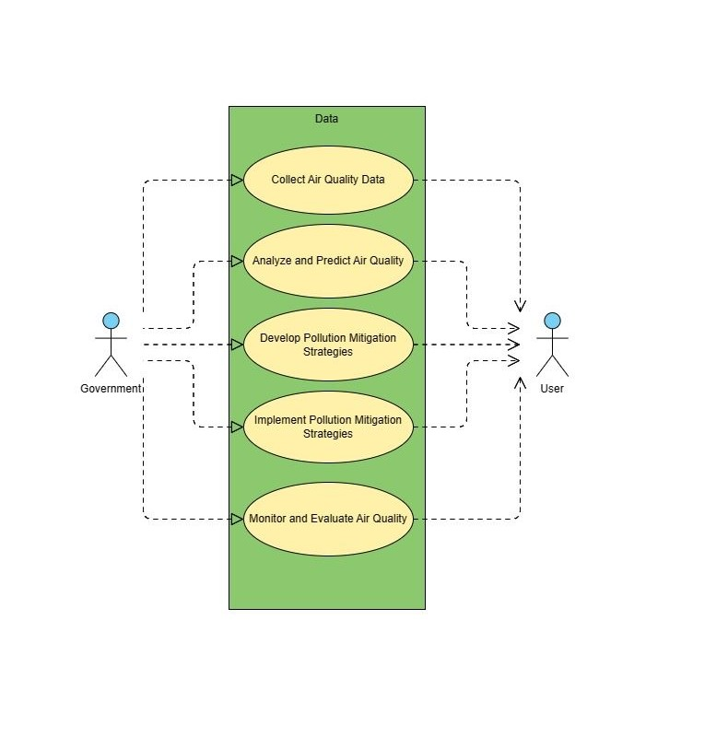
Use Case Diagram

Slide 12
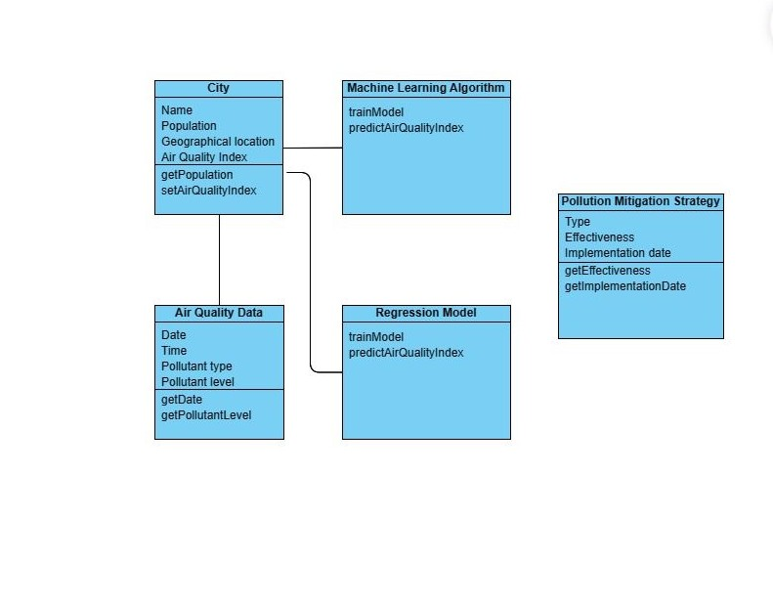
Class Diagram

Slide 13
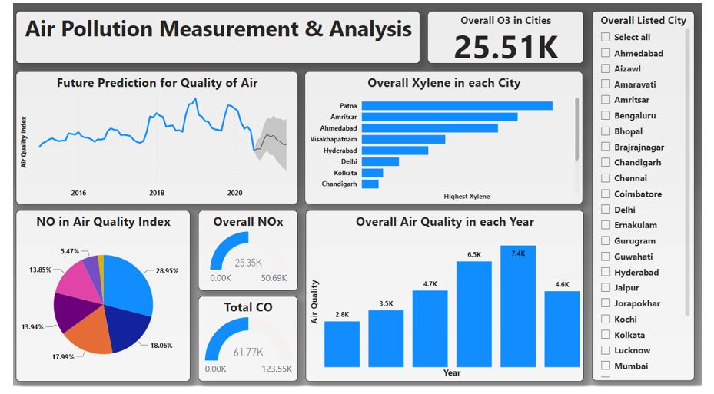
Power-Bi Dashboard
Power BI dashboard analyzes air high-quality records in India. the overall o3 values in the towns are determined to be 25.51K. The dashboard consists of a slicer that lists numerous essential cities in India. Upon studying the xylene levels, Patna is observed to have the very best peak while Mumbai has a decrease stage. A pie chart indicates that the mild air great class is the very best, making up 28.95 of the total, even as the coolest air first-class category best makes up 1.74. additionally, the records suggests that out of 123.55k, there are 61.77k CO gauges, and out of 50.69k, there are 25.35k NOx gauges.

Slide 14
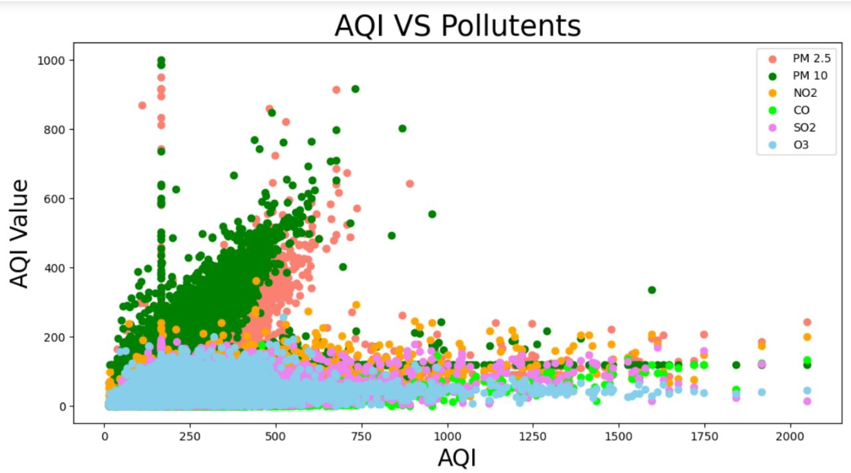
Scatter Chart
This proposed method plots the Air best Index (AQI) versus degrees of various pollution. Contaminants taken into consideration here are PM 2.5, PM 10, NO2, CO, SO2, and O3. The statistics are first split into two arrays x and y1-y6. x carries the AQI values and y1-y6 incorporates the contaminant values. Then use the ’plt.scatter()’ function from the matplotlib library to create a scatterplot with the AQI values (x) on the x-axis and the contaminant values (y1-y6) on the y-axis. every contaminant is represented through a distinct colouration with a corresponding label.

Slide 15
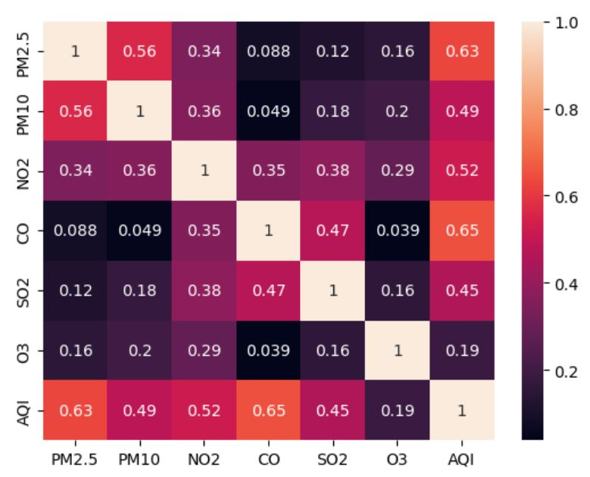
Column Coorelation
This method uses the Pandas and Seaborn libraries to compute correlations among one-of-a-kind columns of a dataset. The ’new-data.corr()’ function computes the correlation between all columns of the facts set ’new-data’. this may come up with a correlation matrix displaying the correlation coefficients among every pair of columns. Then use the Seaborn library to create a heatmap of the correlation matrix with the use of the sns.heatmap() characteristic.

Slide 16
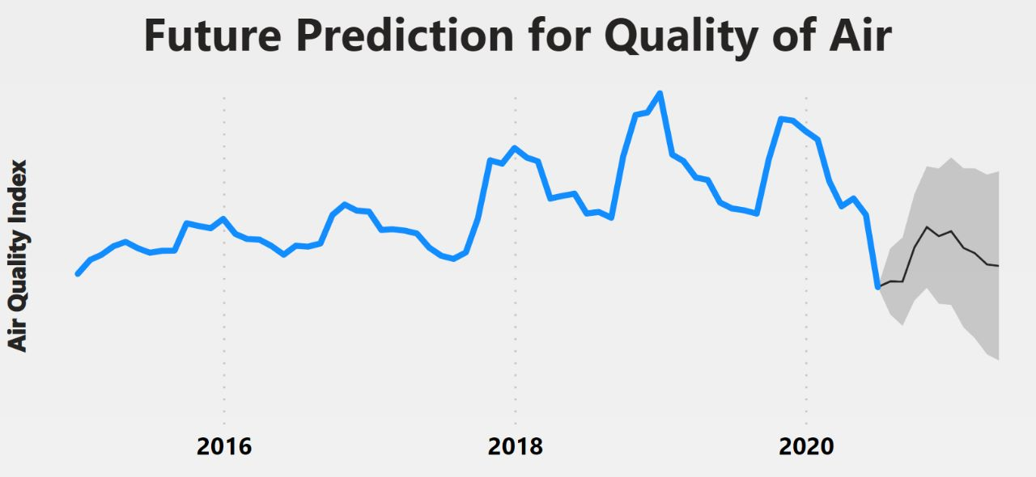
Future Prediction
Forecasting the satisfaction of air includes user statistics and systems to gain knowledge of techniques to are expecting destiny air pleasant based on historical records. The aim is to provide correct and well-timed information to assist policymakers, stakeholders, and the public make knowledgeable selections about coping with air pollution and defensive public health. Several factors have an impact on air fine, along with climate situations, geographical vicinity, population density, and human sports which include transportation and business manufacturing.

Slide 17
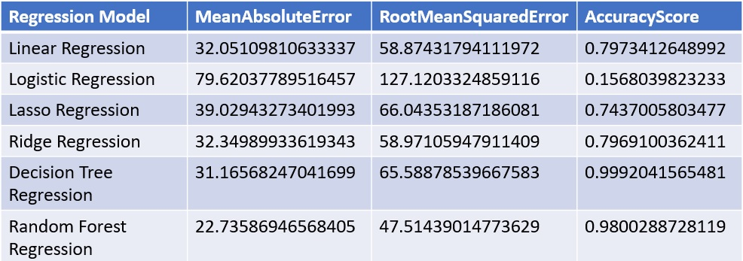
Result

Slide 18
Conclusion
In conclusion, we implemented six specific regression fashions to expect AQI values based on contaminant tiers, namely Linear Regression, Logistic Regression, Lasso Regression, Ridge Regression, Decision Tree Regression, and Random Forest Regression.
The Random Forest Regression version carried out the best performance, with the lowest MAE and RMSE values and an Accuracy score of 0.980.
This indicates that the Random Forest Regression model is the most correct and reliable technique for predicting AQI values based on contaminant ranges.
Further assessment and trying out on unseen statistics may be essential to verify the generalizability and robustness of the model. general, the take look highlights the significance of the use of regression fashions for predicting AQI values, which can aid in managing and mitigating air pollution and its health results.

Slide 19
THANK YOU

